Slide 1

Minh Thien Nguyen MSDS696 data science practicum 2 Regis university August - 2018

Slide 2
Project summary
The goal of this project is to build machine learning models to predict the credit default risk. This project is from the kaggle competition. In this presentation I will talk about five points:
Data source and data description
Initial data exploratory
Steps to clean data
Merge all data
Build gradient boosting
Source code
https://github.com/minhthien/practicum2-credit-default-risk

Slide 3
I. Data source and data description
application_{train|test}.csv
bureau.csv.
bureau_balance.csv
POS_CASH_balance.csv
credit_card_balance.csv
previous_application.csv
installments_payments.csv
https://www.kaggle.com/c/home-credit-default-risk/data

Slide 4
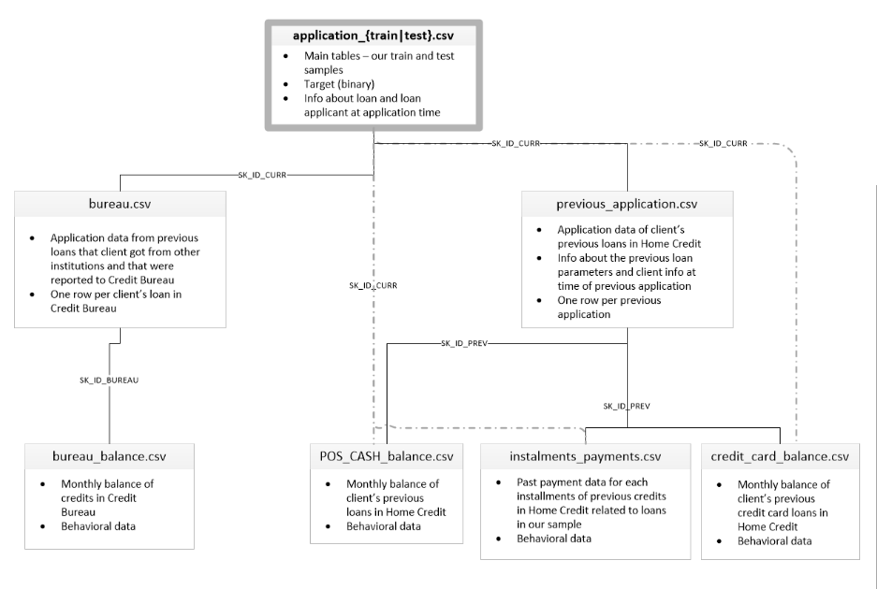
I. Data sets relationship

Slide 5
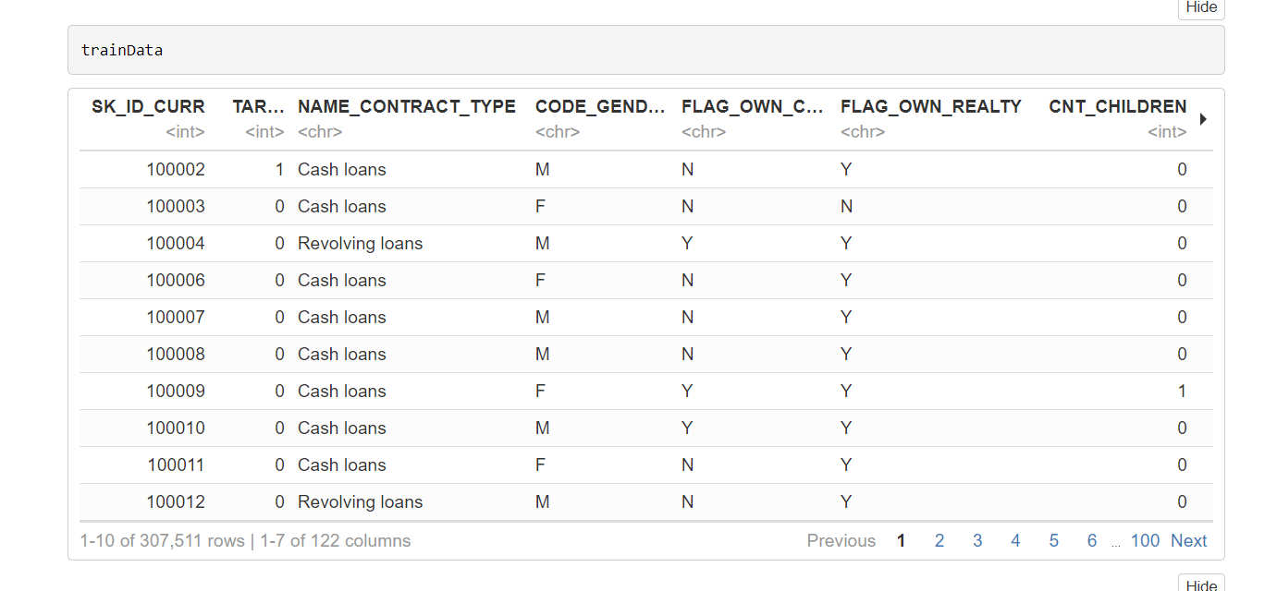
II. Initial Data Exploratory application_train.csv

Slide 6
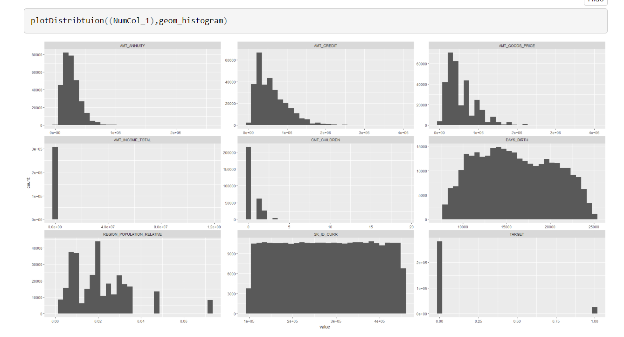
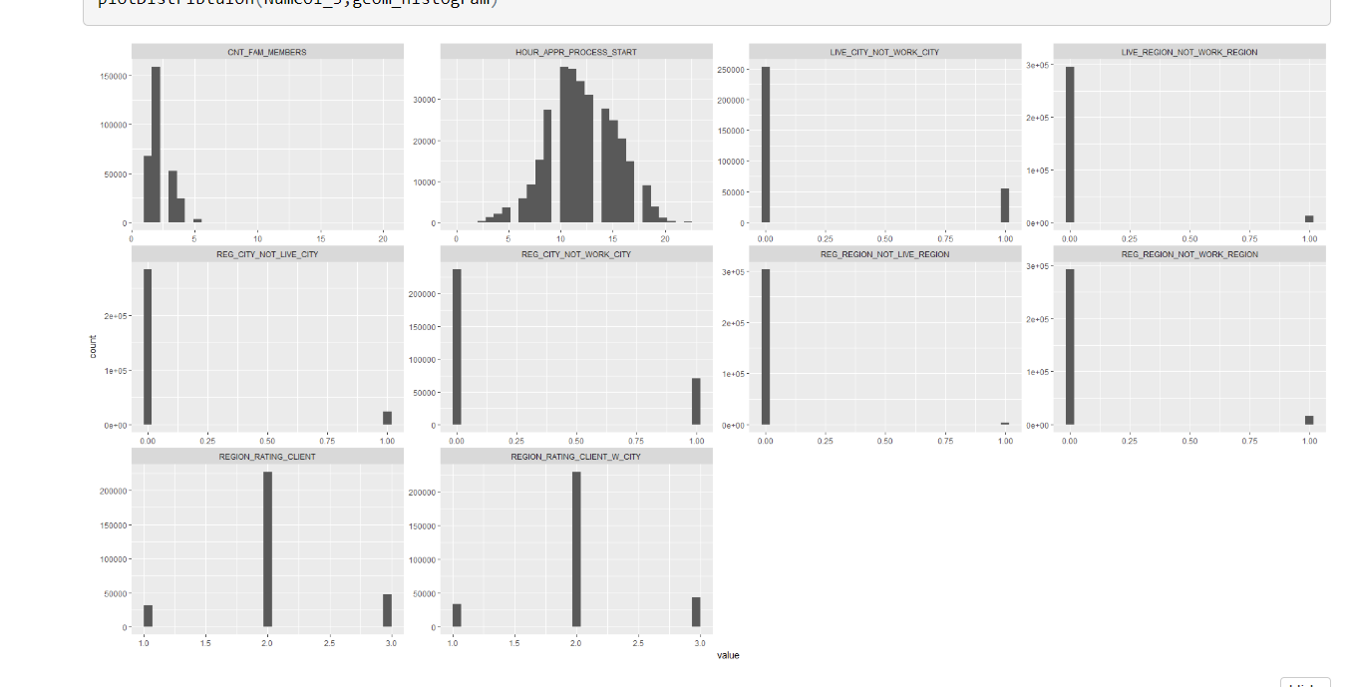
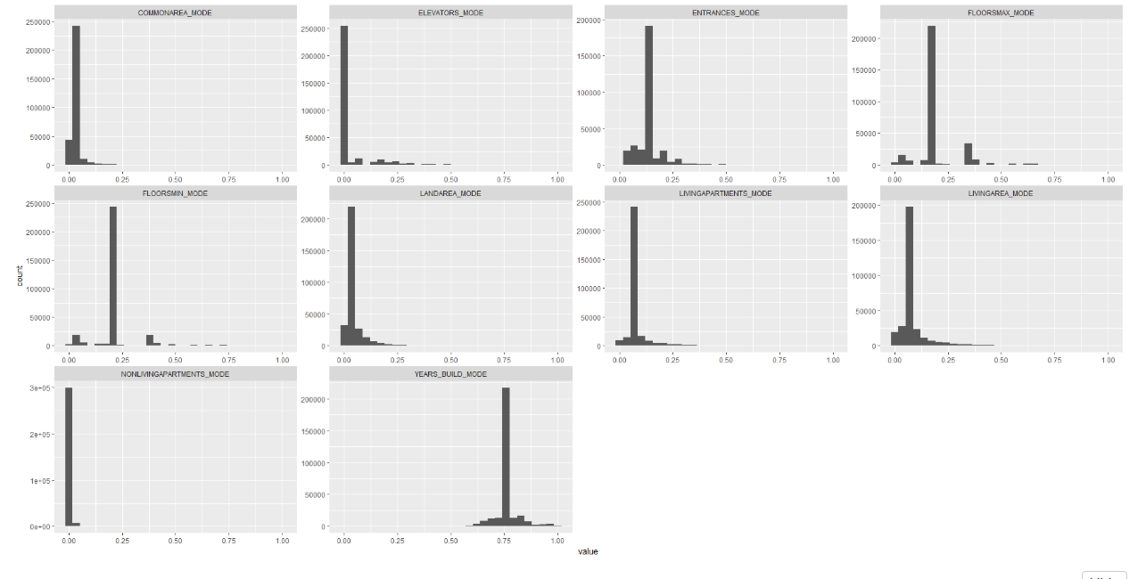
II. Initial Data Exploratory application_train.csv
Numeric features in application train data set
Right skew
discrete value

Slide 7
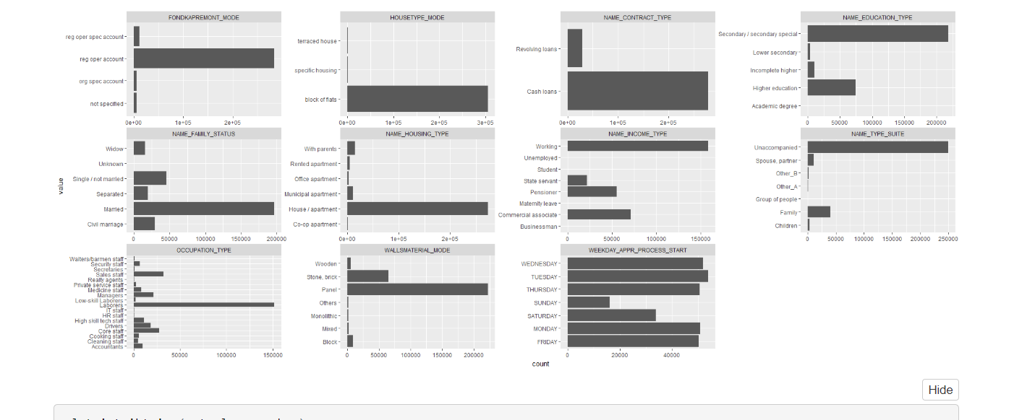
II. Initial Data Exploratory application_train.csv
Categorical features in application train data set

Slide 8
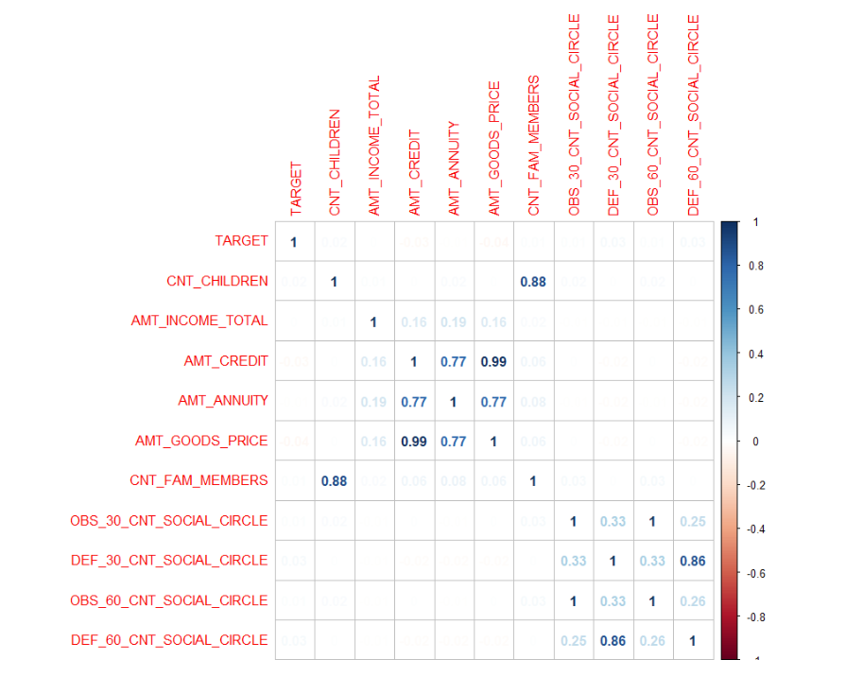
II. Initial Data Exploratory application_train.csv
Pick some features
that we think important for Correlation graph

Slide 9
III. Steps to clean data application_train.csv
Numeric feature cleaning step
1. take absolute value for negative numeric features
2. impute missing value with the median of each features
Categorical feature cleaning step
1. impute missing value with the mode of each features
2. label encoding
The same step was done for application_test.csv

Slide 10
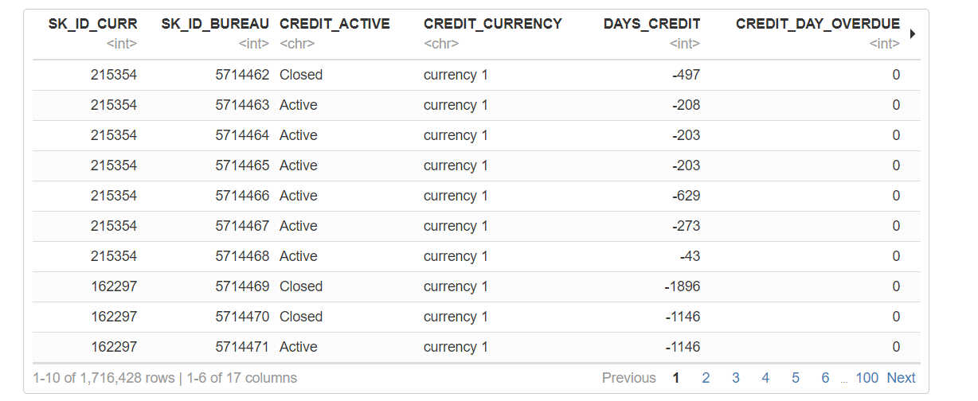
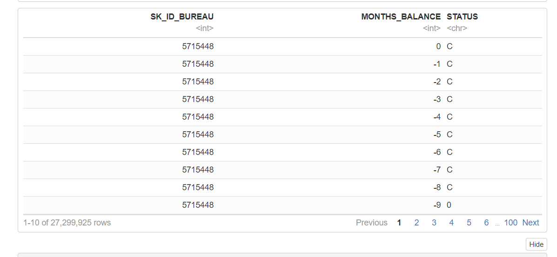
II. Initial Data Exploratory bureau.csv and bureau_balance.csv

Slide 11
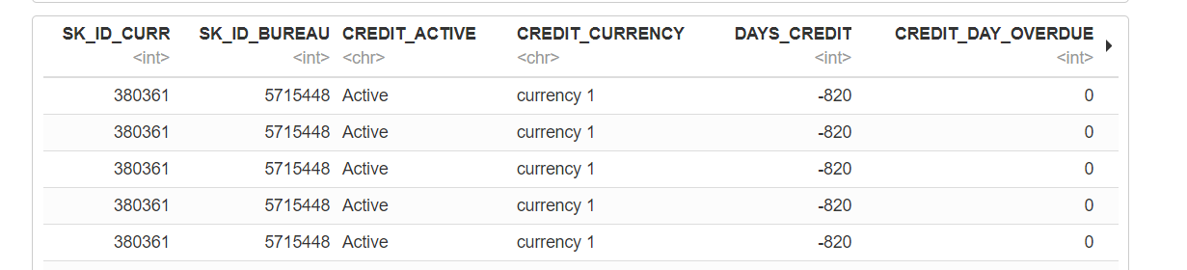
III. Steps to clean data bureau.csv and bureau_balance.csv
After
Numeric feature cleaning step
1. take absolute value for negative numeric features
2. impute missing value with the median of each features
3. summing each features per client
Categorical feature cleaning step
1. impute missing value with the mode of each features
2. get the total counts of each levels in a features and make each levels a feature
Then remove features which have missing value > 0.9

Slide 12
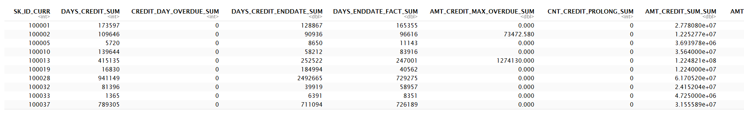
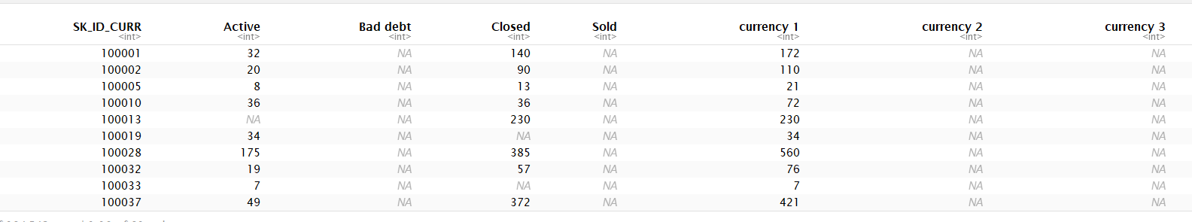
III. Steps to clean data bureau.csv and bureau_balance.csv

Slide 13
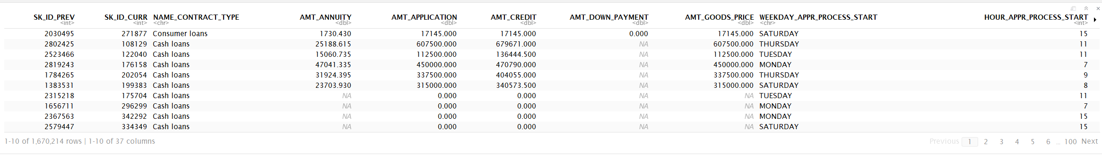
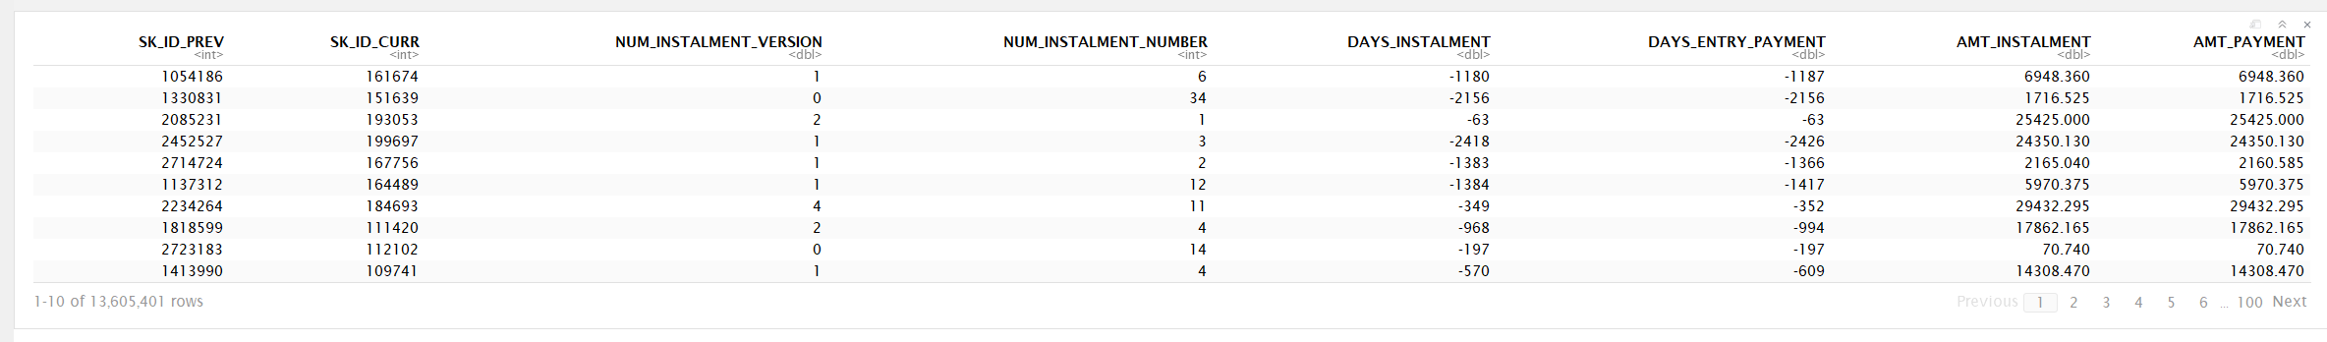
II. Initial Data Exploratory previous_application.csv and installments_payments.csv

Slide 14
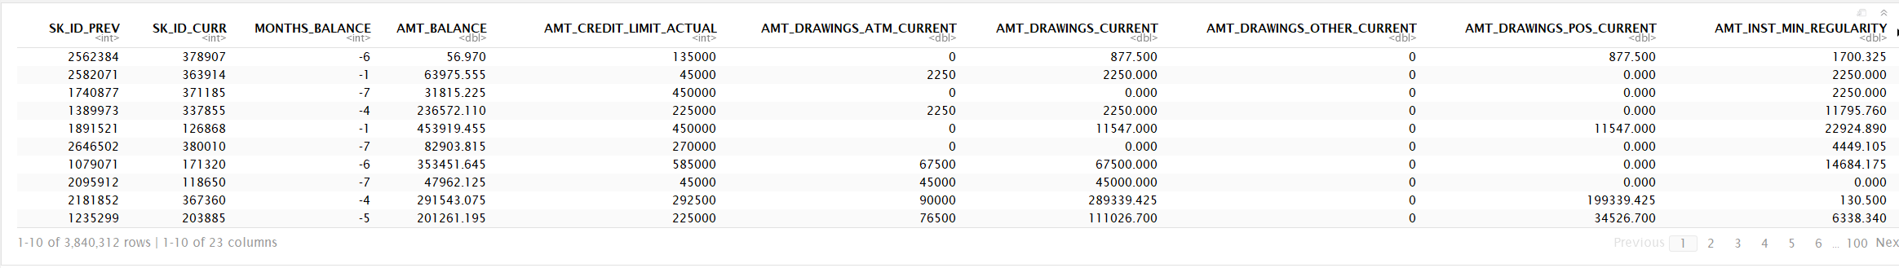
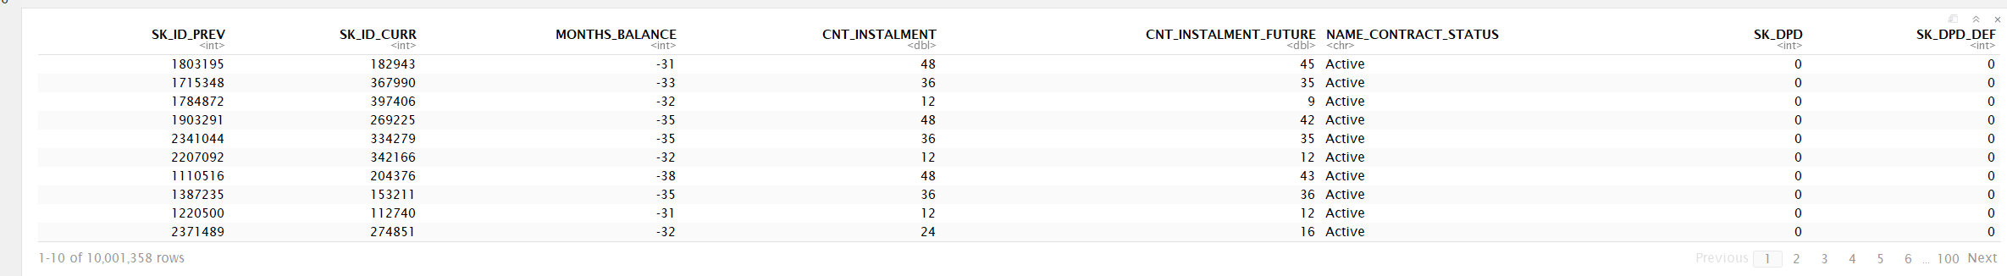
II. Initial Data Exploratory credit_card_balance.csv and POS_CASH_balance.csv

Slide 15
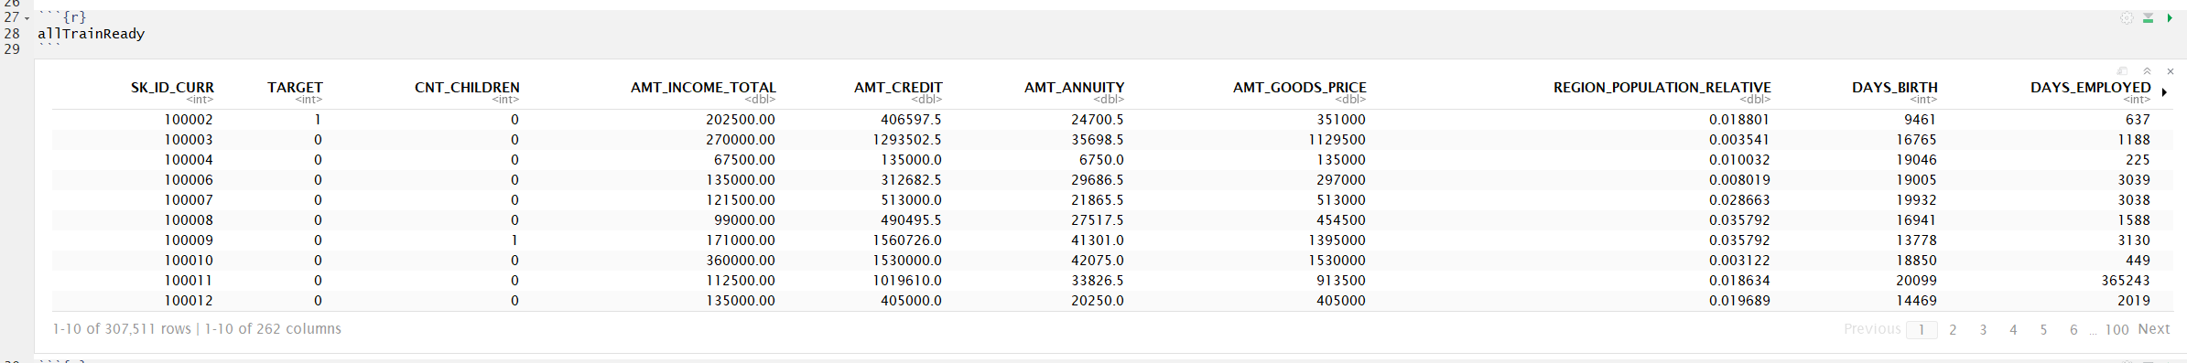
IV. Merge all data

Slide 16
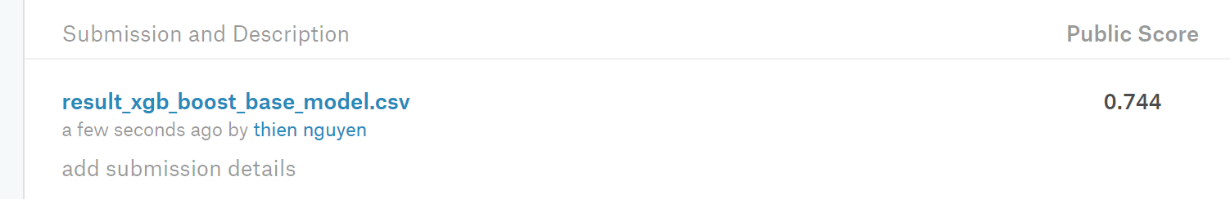
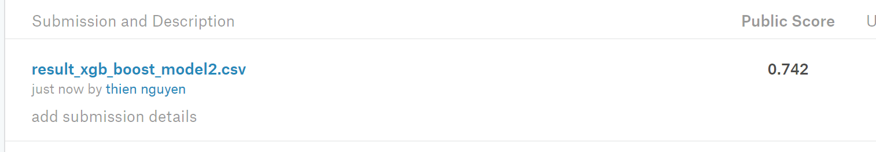
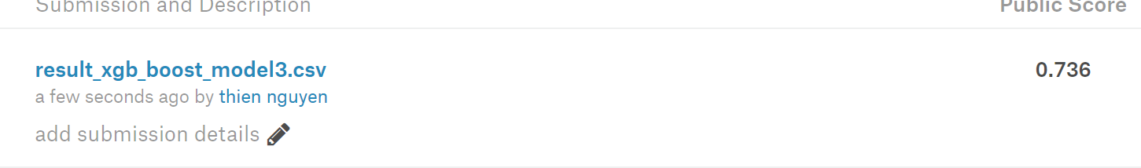
V. gradient boosting with just application_train.csv
Nrounds = 250
eta = 0.1
nfold = 3
With imputation and label encoding
With imputation and label encoding added a feature anu_icome_ratio = AMT_ANNUITY/AMT_INCOME_TOTAL
With imputation and label encoding added a feature anu_icome_ratio = AMT_ANNUITY/AMT_INCOME_TOTAL and high correlated features removed

Slide 17
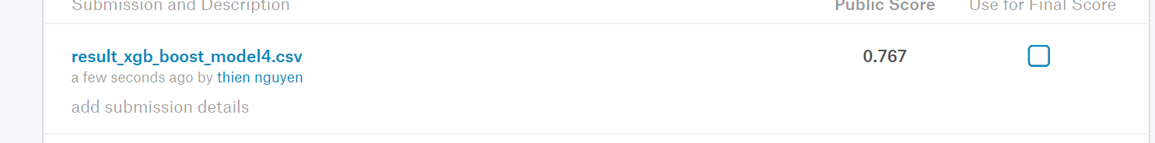
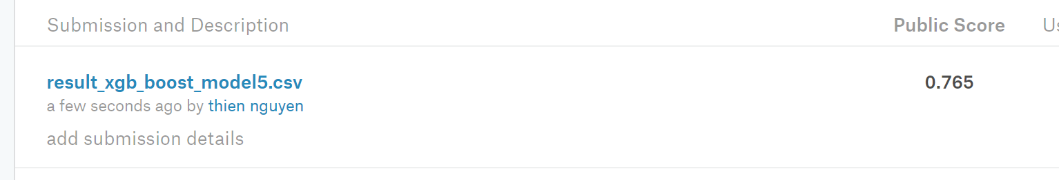
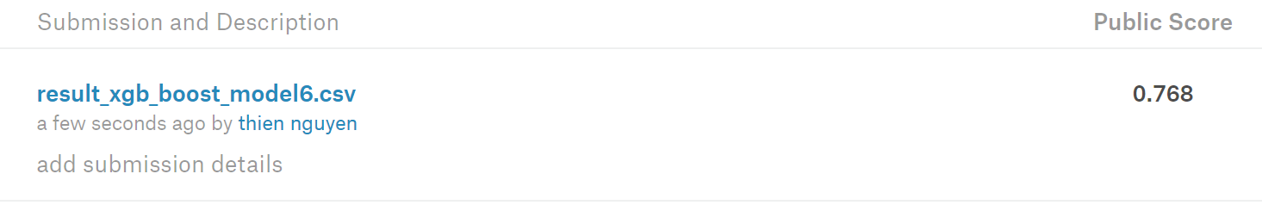
V. gradient boosting with all data combined
With all data still have missing value
With all data features with missing value > 85% removed
with all data and all missing value median impute

Slide 18
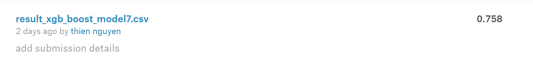
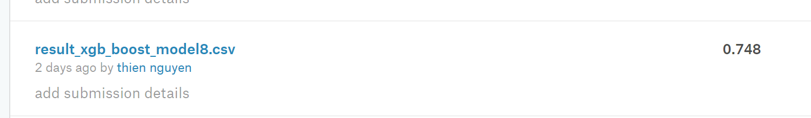
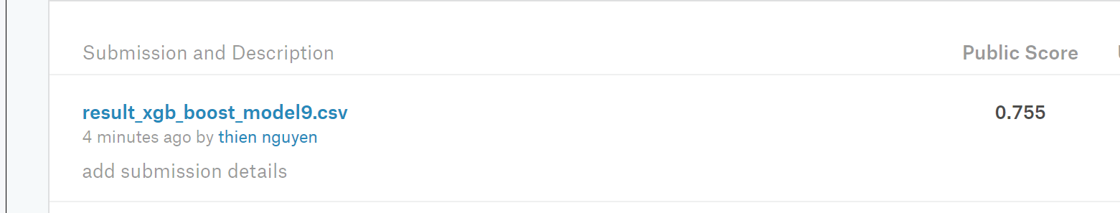
V. gradient boosting with all data combined
with all data and all missing value mean impute
with all data and all missing value median impute and high correlated feature removed
with all data with median impute (nrounds = 5000 eta = 0.005)

Slide 19
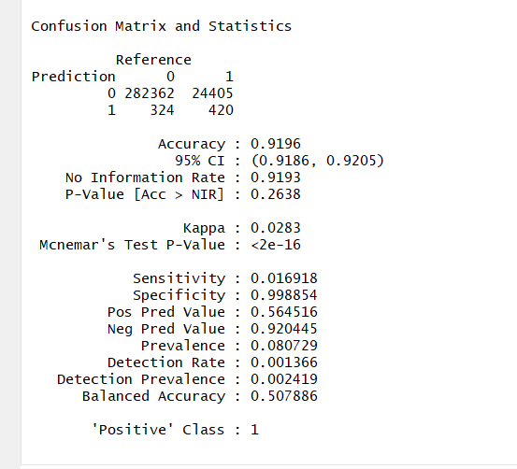
Model 9
[1] "falsePositiveRate" [1] 0.001146148 [1] "falseNegativeRate" [1] 0.9830816
the low falsePositiveRate tell us this model is good at identify good clients . the high falseNegativeRate which tell us this model is bad as identify bad clients. falseNegativeRate is important for this application since we want the model to be good at identify bad clients so the company won't make bad loans.

Slide 20
summary
Data source and data description
Initial data exploratory
Steps to clean data
Merge all data
gradient boosting

Slide 21
Conclusion and discussions
Model6 give best performance( model 6 is with all data and all missing value median impute)
Remove high correlated feature decrease performance
Remove Features with missing value > 85% decease performance
Tune gradient boost with nround = 5000 and eta 0.005 did not improve performance
What to do if have more time
Remove skew in data both response and predictors features
Stack machine learning model
pca feature selection

